Slide 1
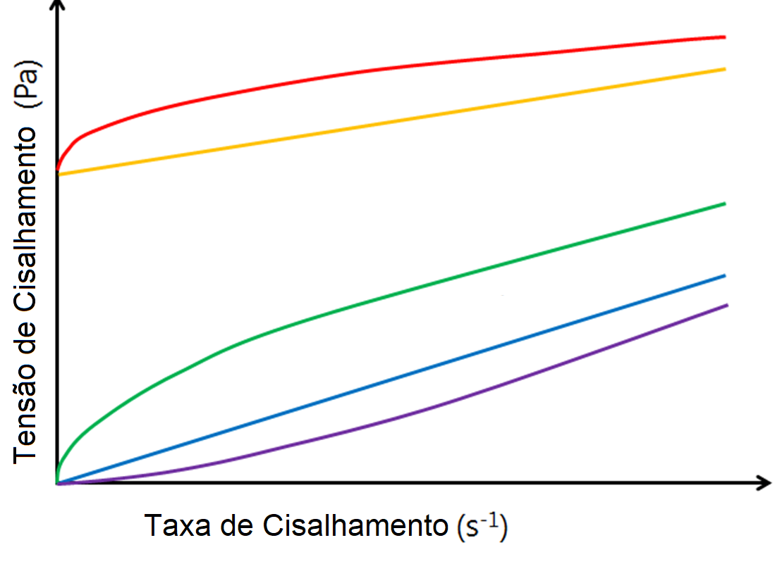
SPACE RESERVED FOR LOGOS OF YOUR INSTITUTION. REMOVE THIS BOX BEFORE APPLYING THE LOGO.
Poster Template for x-BCR 2024
(Arial, size 60, centered and bold)
1st Author's Name1, 2nd Author, 3rd Author (Arial, size 40, centered and bold)
1First Author(s) affiliation(s) and address(s) (Arial, size 32, centered)
Corresponding author e-mail (Arial, size 32, centered)
Introduction (ARIAL, size 40)
Results (ARIAL, size 40)
Conclusion (ARIAL, size 40)
This file is an example for the development of posters for the x Brazilian Conference on Rheology (BCR 2024). Feel free to adjust the quantity, arrangement, and/or dimensions of columns, figures, and tables, as well as to modify font sizes as appropriate to optimize your presentation. The instructions in red serve as suggestions (Arial, size 36 or 32, justified).
The content should be written in English and printed in poster format with a height of 1.2 m and a width of 0.90 m.
The most significant results can be presented in tables and figures.
Table 1 – List the tables in the order of appearance, centered with a text box. (Arial, size 28, centered)
Format |  | Example
-
- | data | -
Arial | Size 36 | -
Shear stress (Pa)
Shear rate (s⁻¹)
Figure 1 – Enumerate the figures in the order of appearance, centered with a text box. (Arial, 28). (Arial, size 28, centered)
Methodology (ARIAL, size 40)
ACKNOWLEDGMENTS (ARIAL, size 40)
The poster presentation should address the following topics concisely and objectively: Introduction, Methodology (Materials and/or Experimental and/or Numerical Procedures), Results and Conclusions. The sections Acknowledgments, and References are optional. Authors are responsible for bringing the printed poster.
This is an optional section.
References (ARIAL, size 40)
This is an optional section.

